Slide 1
Development Services DevOps: Code Quality with CAST AIP

Slide 2
Agenda
Overview (15 min):
Quality in context of the DevOps Value Chain
Why Code Quality
Layers of Code Quality Assurance
What is CAST AIP
Demonstration of CAST AIP (20 min)
Engineering Dashboard
Application Analytics Dashboard
Stakeholder View Points (20 min) with open Q&A
Jackie Bach, Director
Avinash Misra, Loan Accounting Platform
Yehuda Shem-Tov, Credit Technology
Don D’souza, Manager

Slide 3
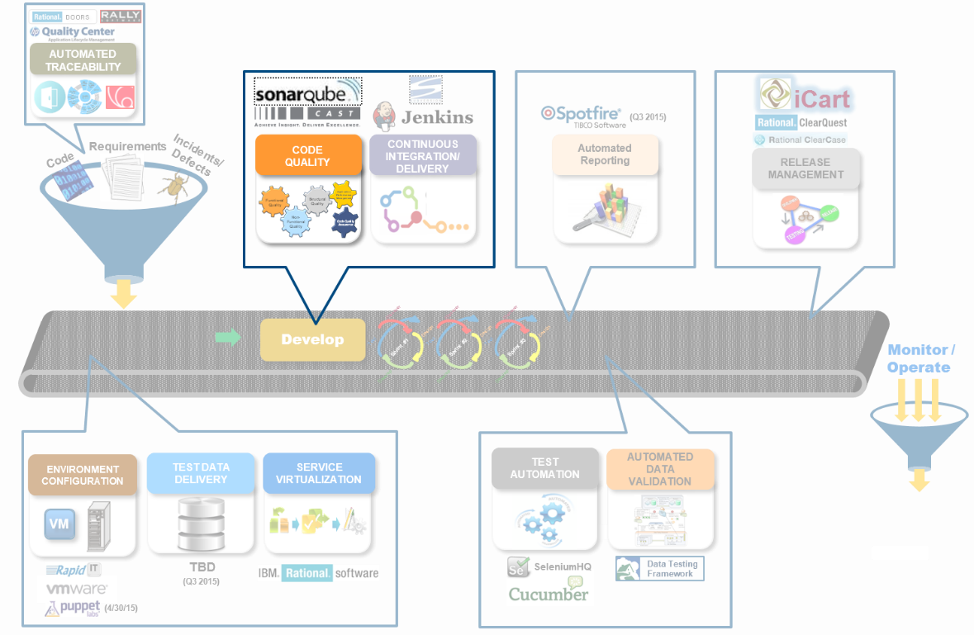
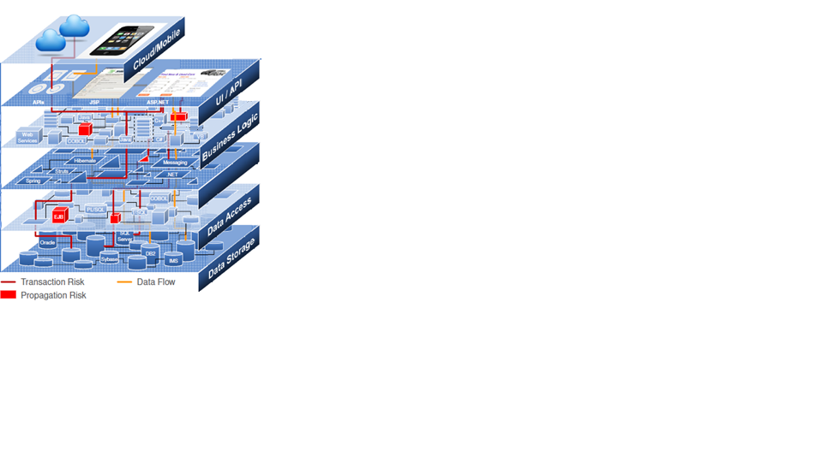
What is Quality in DevOps?
DevOps Value Chain
Application Quality
Dimensions of DevOps Quality:
Structure/Architecture
Build/Integration (CI/CD)
Functionality/Non-Functionality (Traditional QA – Testing)
Component/Code (Practices and IDE Tools)
Tools/Libraries (ITAM)
Application Lifecycle (ALM)
Structural Quality via CAST AIP

Slide 4
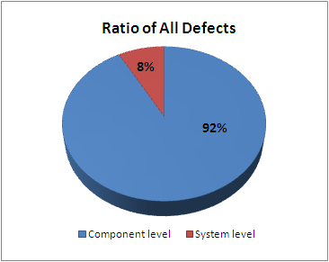
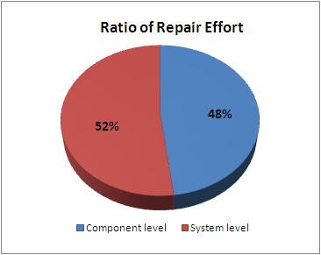
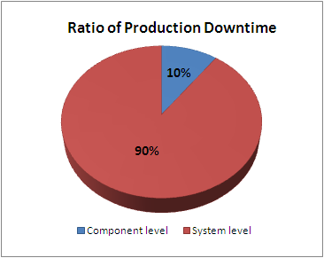
Why Structural Quality?
Visible Behavior of the System as measured against Specifications
How well the application is design and implemented
Functional Quality
Structural Quality *
Software Quality
Non-Functional Quality
Accountability to Requirements
Absence of functional & NFR defects
Low Maintainability Cost
High Reliability, Efficiency & Performance
High Structurally Soundness
Stable, Secure, and Scalable
Low Technical Debt
“Defined Functional Behavior of the System”
“Visible Behavior of the System”
“Quality of Architecture, design, and construction”
* Based on CISQ Structural Quality characteristics
Industry Benchmark of Impact on Production
SONAR addresses the component level; CAST addresses the 8% system/integration causing the highest ratio of production downtime
* Data based on CISQ (Consortium of IT Software Quality) study conducted for the DoD.
Notes:
Testing, ALM tools, and SDLC provide accountability to requirements, quality software has a variety of attributes not connected to requirements .
Consistency, Maintainability, Reliability, Structure, Efficiency, and Security.
Outcomes:
Drive consistent quality in design and code
Validate code from vendors meets quality standards
Early prevention when it costs less to correct
Reduce software risks to FNM
Improve system stability and performance
Reduce system level flaws that cause downtime
Higher quality = improved maintainable code

Slide 5

Why CAST AIP?
Enterprise Software Quality
CAST Highlight : Enterprise View
“mile-wide, inch deep”
CAST Application Intelligence Platform (AIP): Portfolio View
“deep analysis based on what is on the CAST AIP Platform”
Application Quality
Dev Ops Quality | App Layers | Activity (Tool)
Architecture & Structure | System | CAST AIP
Integration & Build | System | CICD (Jenkins with Sonarqube & CAST)
Security | System | Static Code Scans (Fortify + CAST AIP) & CURL (CAST provides early detection)
Design | Component | Peer Review (Crucible) + Static Code Scans (Sonarqube & CAST AIP) + CLM for Third Party Component Scans
Construction | Code | Peer Review (Crucible) + Static Code Scans with IDE (Sonarqube, CAST, PMD, CSA)

Slide 6
What is CAST AIP?
A platform tool for analyzing applications on code quality.
Provides component, build, and system level quality analysis
Focuses on the 8% of issues that cause 90% of the production outages
Scans multiple technologies (Java, .NET, Oracle, Informatica, etc)
Categorizes and prioritizes quality findings based upon impacts and likelihood of occurrence
Scans code for quality findings based upon structural components defined by created meta model; Does not plug into an IDE like SonarQube
When paired with other tools (PMD, SONAR, and Crucible) and performing regular scans (every sprint), we have seen high levels of quality improvements – 36% to 48%
Objective: Drive higher quality for faster time to market and early system level defect detection at the Architectural level.
CAST claim: 10 – 50% reduction in source code defects
FNMA: 10 – 48% with a median of 18% & average of 24%

Slide 7
Demo of CAST AIP
Engineering Dashboard
Application Analytics Dashboard (AAD)
Reports

Slide 8
Stakeholder Point of View
Jackie Bach, Director
Avinash Misra, Manager of LAP
Yehuda Shem-Tov, Manager
Don D’souza, Manager

Slide 9
Appendix
Reference Materials

Slide 10
Tool by Technology Coverage Matrix
Technology\Languages | SONAR | AIP | Fortify | Crucible | PMD | CSA¹
Java |  |  |  |  |  | 
Microsoft .NET |  |  |  |  |  | 
Oracle PL\SQL | ² |  |  |  |  | 
TIBCO BW |  | A³ |  |  |  | 
Informatica |  |  |  |  |  | 
Microsoft VB\VB.NET\VB Script | ² |  |  |  |  | 
Web (HTML, JSP/JSF) | ² |  |  |  |  | 
XML | ² |  |  |  |  | 
C, C++, C# | ² |  |  |  |  | C#
Business Objects |  | A |  |  |  | 
Key
Footnotes


A
Detailed scan support
Does not scan
Architecture scan only
1 CSA = Cigital SecureAssist (security plugin to Eclipse)
Not yet available within FNM but provided through plug-ins via sonarsource
Custom rule set being evaluated for inclusion in Q3

Slide 11


CQA Tooling in Context of Agile
Micro Work Increments: Issues identified during recurring in-sprint scans captured as tasks to a story or added to Release Backlog.
Sprint Planning: Final build scan identifies quality issues to be addressed as stories or tasks in the sprint\increment backlog.
Sprint/Increment
Work Cycle
✓
✓
✓
Release Backlog
Sprint\Increment
Backlog
Working Code
Project Planning:
Scan of production application (baseline)
provides input into product backlog by
Identifying existing structural quality issues.
Sprint\Increment Retrospective: End of sprint\increment final build scan provides insight into identifying repetitive programming issues for development process improvement.
End of Sprint\Increment Build: End of sprint\increment final build is scanned. Issues identified captured as stories or tasks in the release backlog for a future sprint\increment.

Slide 12
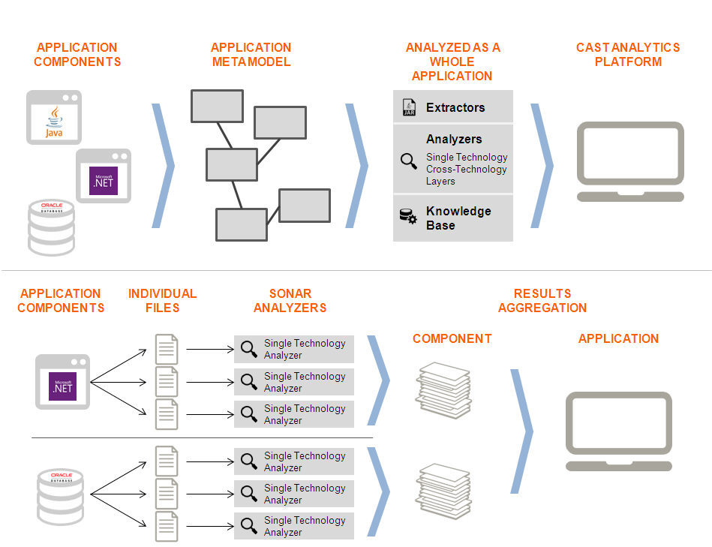
CAST AIP & SONAR Use Scenarios
Use Cases for Code Quality Assurance
CAST AIP with SONAR: project utilizes SONAR to find the easy to find defects at the component level and CAST AIP to find structural quality issues at the system level.
Agile w/wo CI environment: Utilize SONAR throughout the development lifecycle with CAST AIP scans performed once every sprint. Deep dives are performed with CAST AIP results on baseline, concrete builds.
Waterfall\Modified Waterfall: Utilize SONAR throughout the development lifecycle with CAST AIP scans performed once every sprint. Deep dives are performed with CAST AIP results on baseline, concrete builds
CAST AIP: project utilizes the CAST AIP platform for left-shifting Code Quality at both the component and structural level.
Agile w/wo CI environment: run a scan once or twice a week and at the end of each sprint. Note that scans run more than twice a week tends to flat line the trending resulting in minimization of delta-based analysis of quality trends. Deep dives are performed on baseline, concrete builds.
Waterfall\Modified Waterfall: run a scan at the end of each code drop with deep dives performed when drops are baselined.
CAST AIP provides structural code analysis as a whole by building an architectural meta model as realized by the code. Code is analyzed at the component, transactional, and system level with results aggregated and organized by a risk framework.
Application architectural focus with enterprise roll-up
Focus on CQA for architecturally significant and system structural elements
Risk based model for prioritization aligning with the RTF
Provides summary to detailed trending analysis across application characteristics
Issue: CAST AIP quality metrics become watered down with high frequency scans.
SONAR provides component level code analysis by analyzing individual components that requires aggregation by the user.
Deep Application component focus allowing for depth of CQA analysis on components
Executed at the IDE level allowing projects to perform CQA as code is being constructed on the developer workstation
Ideal for agile CICD practices
Provides teams the capability to fine tune rules applied at the component level for application-specific coding practices

Slide 13
Recommended Use Patterns
1. Scenario: DevOps using Sonar and CAST AIP
Sprint ix\Drop Cycle
Sprint ix+1\Drop Cycle
Sprint ix +2\Drop Cycle
wk1
wk2
wk3
wk4
wk1
wk2
wk3
wk4
wk1
wk2
wk3
wk4
etc.
SONAR
SONAR
SONAR
CAST AIP
Benchmark Scan
CAST AIP
Benchmark Scan
CAST AIP
Benchmark Scan
2. Scenario: non-DevOps with CAST AIP
Sprint ix\Drop Cycle
Sprint is+1\Drop Cycle
Sprint is+2\Drop Cycle
wk1
wk2
wk3
wk4
wk1
wk2
wk3
wk4
wk1
wk2
wk3
wk4
etc.
CAST AIP
Benchmark Scan
CAST AIP
Benchmark Scan
CAST AIP
Benchmark Scan
Sprint x\Drop Cycle
Terms
Benchmark scan: CAST AIP Quality scan that is retained as a time-in-point quality benchmark for the application across concrete builds\certified builds\incremental builds for a given release.
Internal Scan: CAST AIP Quality scans that occur on a weekly or bi-weekly basis to provide a team a means to evaluate quality as a concrete build\certified build\incremental build is constructed within a sprint or drop cycle. Internal scans are only retained one build behind (ix-1)
Option using a more frequent scan for in-cycle CQA:
wk1
wk2
wk3
wk4
CAST AIP
internal scan
CAST AIP
internal scan
CAST AIP
internal scan
CAST AIP
internal scan
CAST AIP
Benchmark Scan

